Slide 1
CDI Resolución de Ejercicios

Slide 2
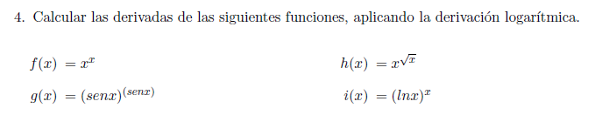

Slide 3

















$$y=f\left(x\right)=x^{x}$$
$$y=g\left(x\right)={(sen x)}^{sen x}$$
$$y=x^{x}$$
$$y={sen x}^{sen x}$$
$$\ln{y}=lnx^{x}$$
$$\ln{y}=ln{(sen x)}^{sen x}$$
$$\ln{y}=x.ln x$$
$$\ln{y}=sen x.ln (sen x)$$
$$\frac{y′}{y}=lnx+x.\frac{1}{x}$$
$$\frac{y′}{y}=\left(cos x\right).ln \left(sen x\right)+sen x.\frac{\cos{x}}{sen x}$$
$$\frac{y′}{y}=lnx+1$$
$$y′=\left[\left(cos x\right).ln \left(sen x\right)+cosx\right].y$$
$$y^{′}= \left(lnx+1\right).y$$
$$y′=\left[\left(cos x\right).ln \left(sen x\right)+cosx\right].{sen x}^{sen x}$$
$$y^{′}=\left(lnx+1\right).x^{x}$$
$y^{′}=x^{x}$+ $x^{x}$. $lnx$

Slide 4
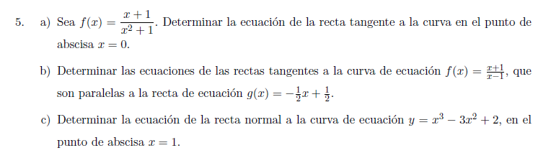

Slide 5


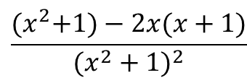






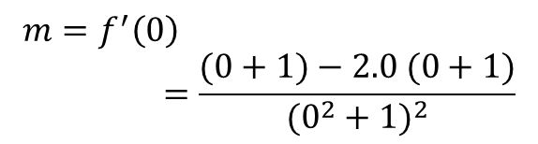






Recta tangente:
$$f\left(x\right)=\frac{x+1}{x^{2}+1}$$
$$x_{0}=0$$
$$\left(x_{0},y_{0}\right)=(0,1)$$
$$m=1$$
$$y−y_{0}=m.(x−x_{0})$$
$$m=f′(x)$$
$$\left(x_{0},y_{0}\right)$$
$$y−1=1(x−0)$$
$$x_{0}=0$$
$$T: y=x+1$$
$$y_{0}=f\left(0\right)=\frac{0+1}{0^{2}+1}=1$$
$$\left(x_{0},y_{0}\right)=(0,1)$$
$$\frac{{(x}^{2}+1)−2x(x+1)}{{(x^{2}+1)}^{2}}$$
$$f^{′}\left(x\right)=$$
$$m=f^{′}\left(0\right)=\frac{(0+1)−2.0 (0+1)}{{(0^{2}+1)}^{2}}$$
$$m=1$$

Slide 6
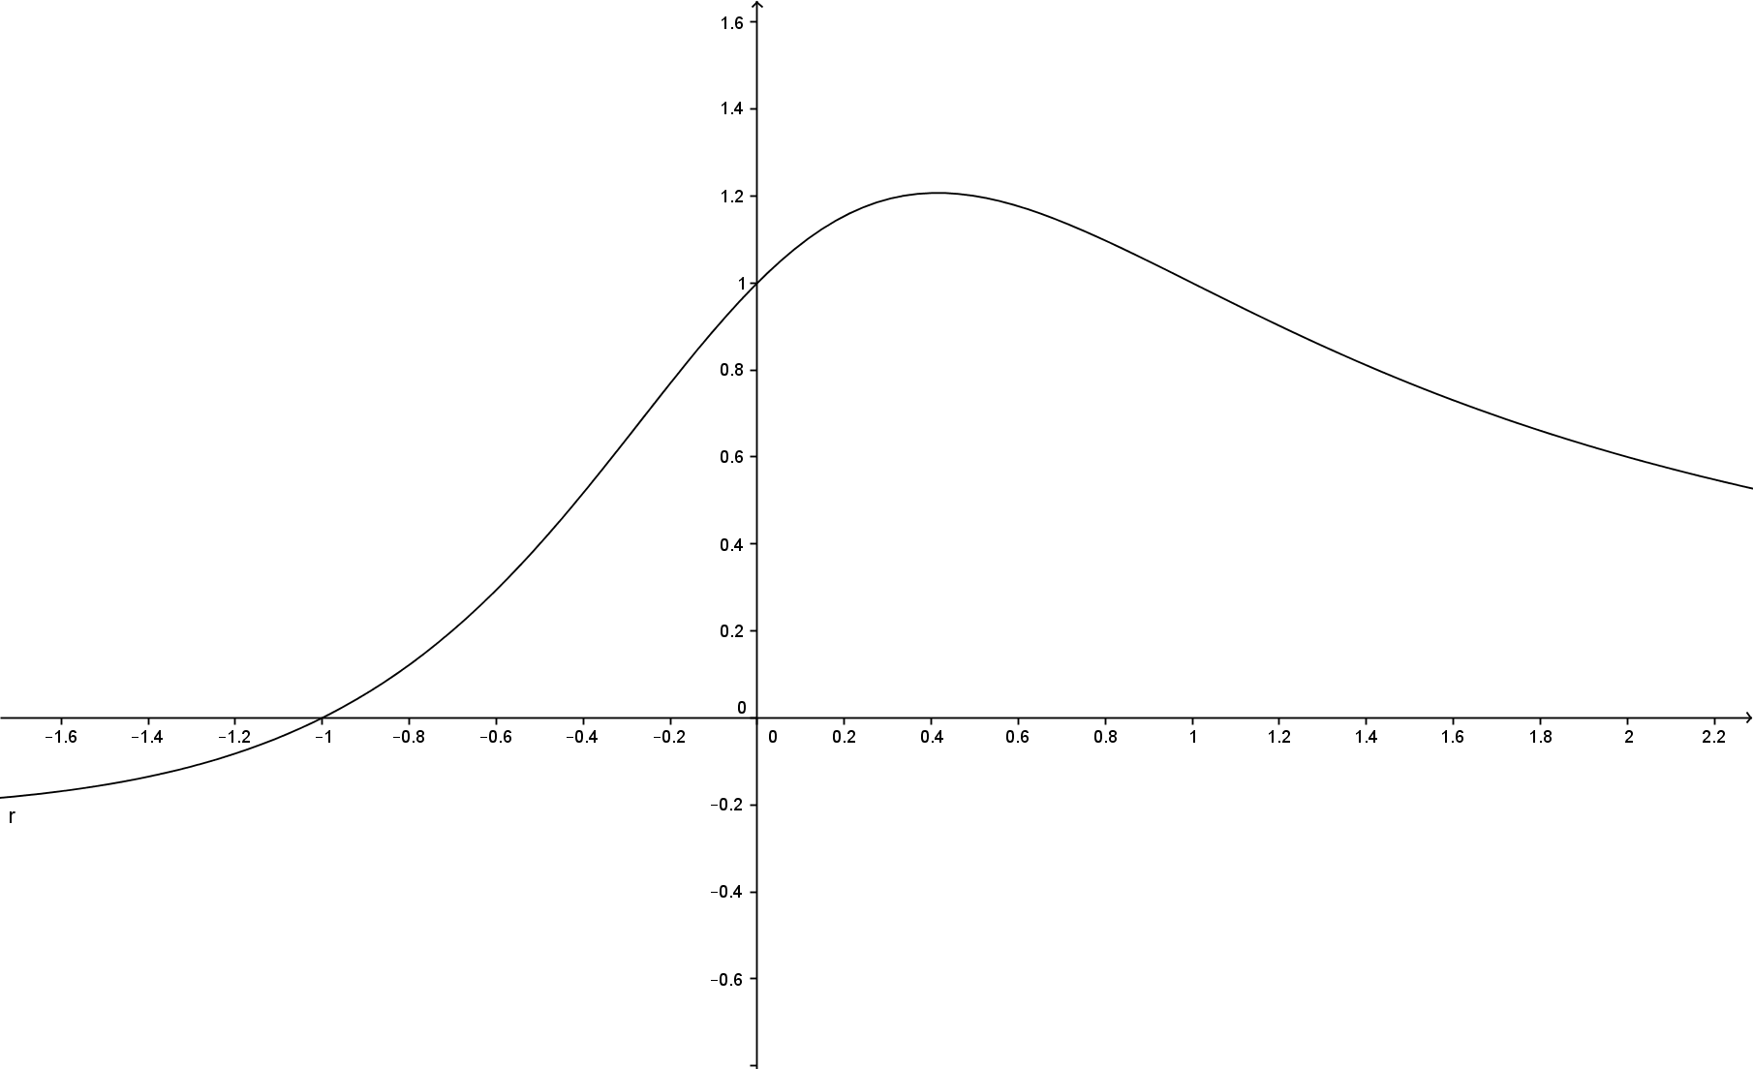


$$f\left(x\right)=\frac{x+1}{x^{2}+1}$$
$$T: y=x+1$$

Slide 7
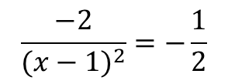

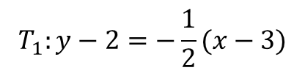



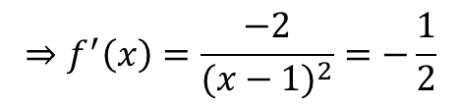

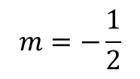
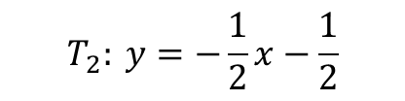


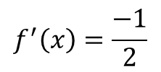
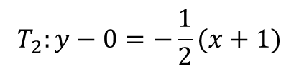
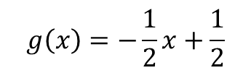

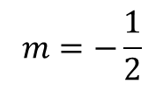

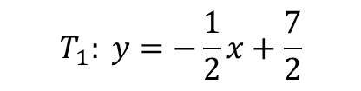





$$f\left(x\right)=\frac{x+1}{x−1}$$
$$g\left(x\right)=−\frac{1}{2}x+\frac{1}{2}$$
$x_{0}=3$
$$y_{0}=f\left(3\right)=2$$
$$\left(x_{0},y_{0}\right)=(3,2)$$
$$m=−\frac{1}{2}$$
$$f^{′}\left(x\right)=\frac{−1}{2}$$
$$⇒f^{′}\left(x\right)=\frac{−2}{{(x−1)}^{2}}=−\frac{1}{2}$$
$$T_{1}:y−2=−\frac{1}{2}(x−3)$$
$$\frac{−2}{{(x−1)}^{2}}=−\frac{1}{2}$$
$$T_{1}: y=−\frac{1}{2}x+\frac{7}{2}$$
$$2.2={(x−1)}^{2}$$
$x_{0}=−1$
$$y_{0}=f\left(−1\right)=0$$
$$4={(x−1)}^{2}$$
$$m=−\frac{1}{2}$$
$$\left(x_{0},y_{0}\right)=(−1,0)$$
$$x−1=±\sqrt{4}$$
$$T_{2}:y−0=−\frac{1}{2}(x+1)$$
$x−1=+\sqrt{4}$
$$⇒x−1=2⇒x=3$$
$$T_{2}: y=−\frac{1}{2}x−\frac{1}{2}$$
$x−1=−\sqrt{4}$
$$⇒x−1=−2⇒x=−1$$

Slide 8
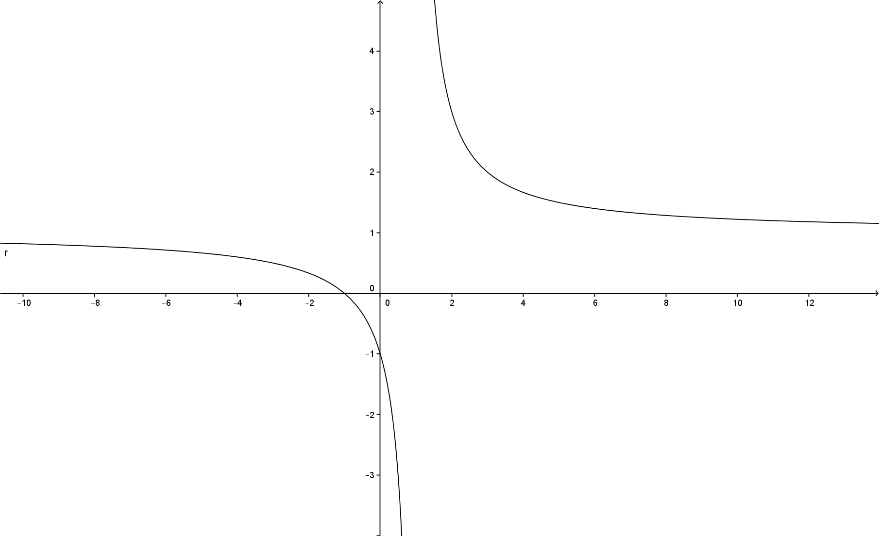

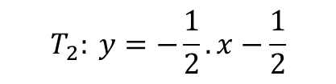
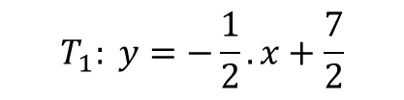
$$f\left(x\right)=\frac{x+1}{x−1}$$
$$T_{1}: y=−\frac{1}{2}.x+\frac{7}{2}$$
$$T_{2}: y=−\frac{1}{2}.x−\frac{1}{2}$$

Slide 9

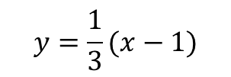


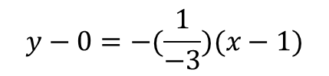
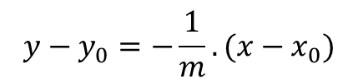





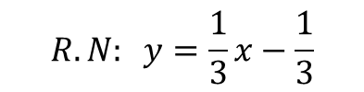
$$f\left(x\right)=x^{3}−3x^{2}+2$$
Recta normal
Ecuación de una recta normal
$$\left(x_{0},y_{0}\right)=(1,0)$$
$$m=−3$$
$$y−y_{0}=−\frac{1}{m}.(x−x_{0})$$
$$y−0=−(\frac{1}{−3})(x−1)$$
$$x_{0}=1$$
$$\left(x_{0},y_{0}\right)=(1,0)$$
$$y=\frac{1}{3}(x−1)$$
$$y_{0}=f\left(1\right)=0$$
$$R.N: y=\frac{1}{3}x−\frac{1}{3}$$
$$f^{′}\left(x\right)=3x^{2}−6x$$
$$m=f^{′}\left(1\right)=3.1^{2}−6.1=−3$$

Slide 10
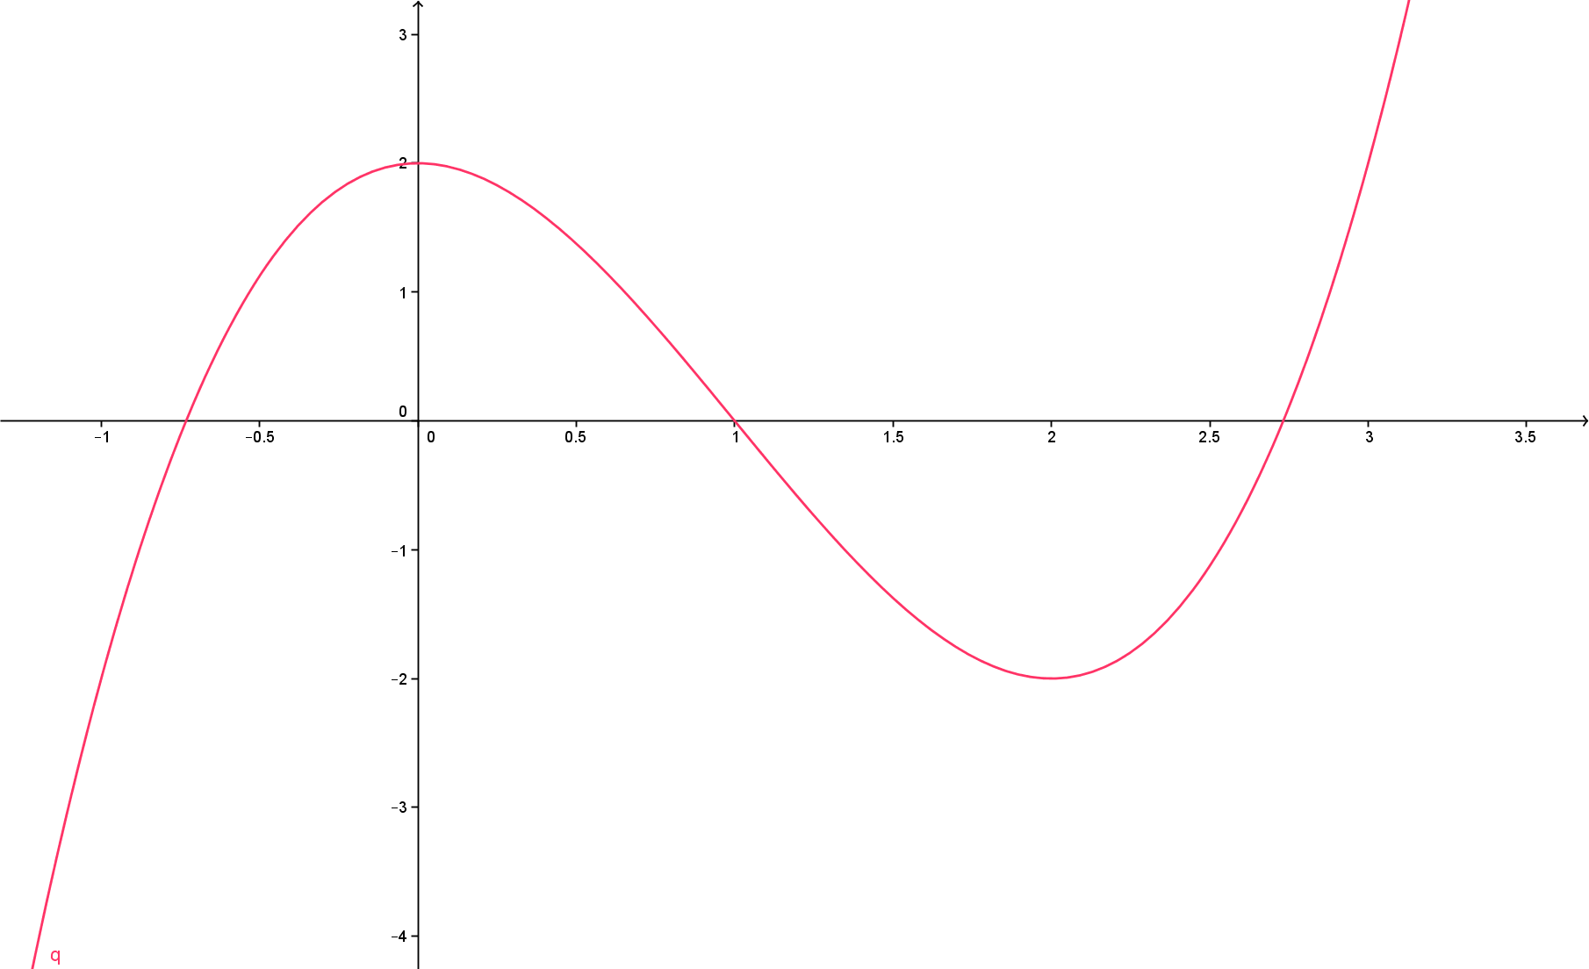

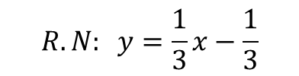
$$R.N: y=\frac{1}{3}x−\frac{1}{3}$$
$$f\left(x\right)=x^{3}−3x^{2}+2$$

